Slide 1
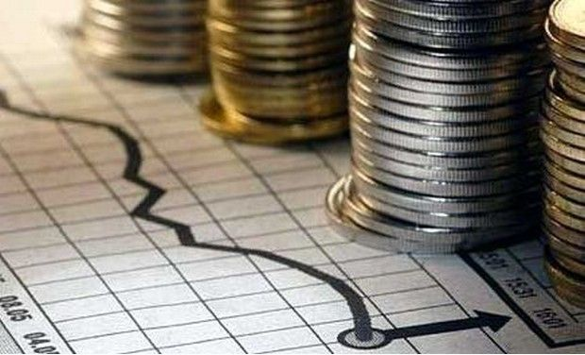
Guaranteed Success
Ecclesiastes 9:11–10:11
Dr. Rick Griffith • Crossroads International Church Singapore
CICFamily.com • BibleStudyDownloads.org

Slide 2
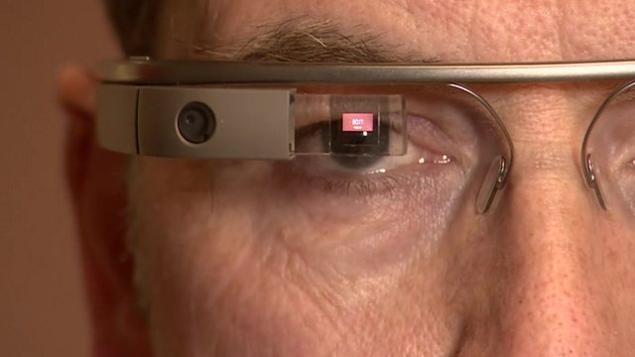
How can you guarantee success?
Notes:
Every one of us wants to me successful in life. But how can you guarantee success? I suspect you would agree with me that human strategies won't work, as they are too simplistic—and, after all, we are Christians who don't buy into these things.

Slide 3
Is wisdom a guarantee for success?
Notes:
If you're wise, will you soon be at the top?
If you're wise, will you eventually succeed then?

Slide 4
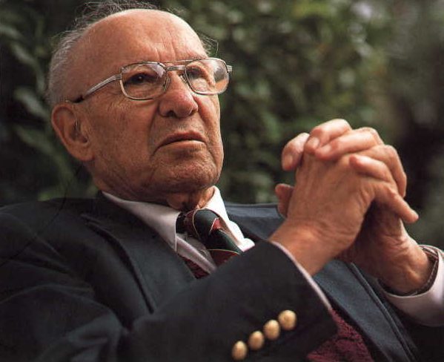
Peter Drucker (1909-2005)
Notes:
If we are honest, we will admit that wisdom doesn't always guarantee success. In fact, the "Peter Principle" may be true!
Peter Drucker is known as the father of modern management

Slide 5
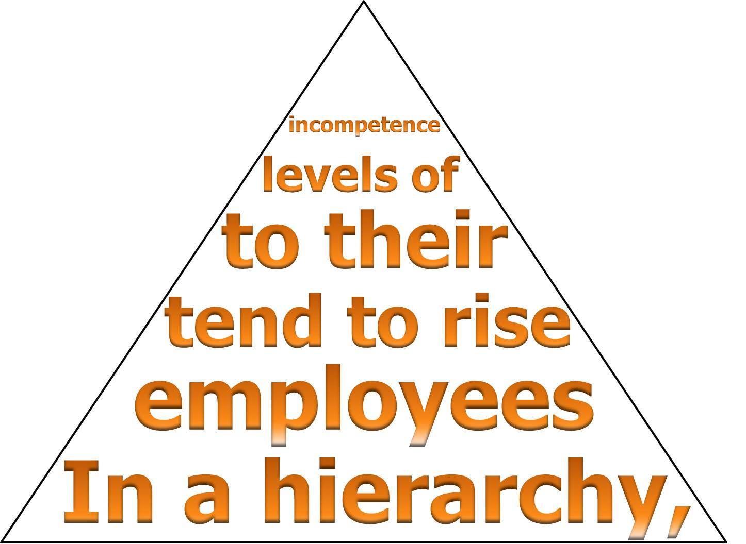
The Peter Principle
incompetence
levels of
to their
tend to rise
employees
In a hierarchy,

Slide 6
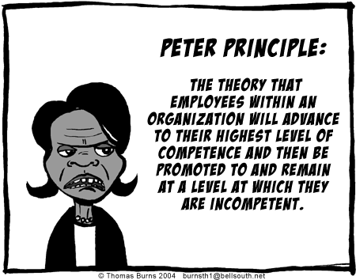
The Peter Principle: The theory that employees within an organization will advance to their highest level of competence and then be promoted to and remain at a level at which they are incompetent.
Notes:
Yet, I submit to you, that whether Drucker is right or not, even genuine wisdom doesn't always guarantee success. But…why not?

Slide 7
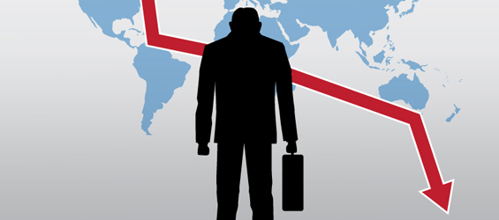
Why doesn't wisdom always lead to success?

Slide 8
Wisdom
Notes:
Solomon was convinced regarding the benefits of wisdom.
He recorded many proverbs to help people be wise.

Slide 9
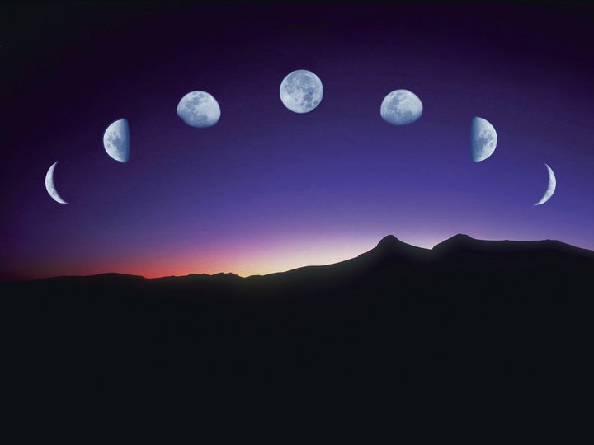
Our Study in Ecclesiastes
Work & Wisdom Don't Last
Notes:
Throughout Ecclesiastes he encourages us to be wise—even though it doesn't ultimately last, it is still good to have wisdom.

Slide 10
Joseph Daniel Nehemiah
Notes:
Joseph (Gen. 37–50) and Daniel (Dan. 1–2) and Nehemiah (Neh. 1–2) are great examples how wisdom brings success—or are they?
If you look carefully, you will see each of these stories notes that "God was with Joseph or Daniel or Nehemiah…"

Slide 11
Why doesn't wisdom always lead to success?
Ecclesiastes 9:11–10:11
Let's see 2 reasons…

Slide 12
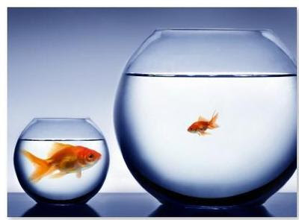
I. Life is unfair (9:11–10:7).
Notes:
The inequities of life afflict the wise as well as the rest of us!
Our existence does not have all accounts settled fairly yet.
Wisdom recognizes this truth that humanity is biased and inequitable.

Slide 13
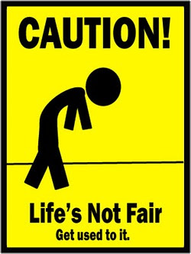
If you are wise, you will get used to unfairness!
CAUTION!
Life's Not Fair.
Get used to it.

Slide 14
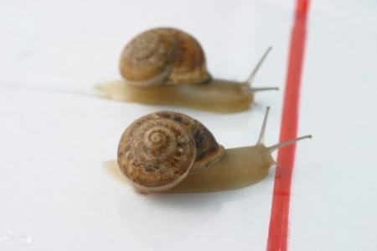
A. Chance can hinder wisdom (9:11-12).

Slide 15
"The fastest runner doesn't always win the race…" (9:11a NLT).

Slide 16
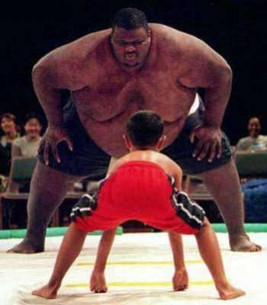
"…the strongest warrior doesn't always win the battle…" (9:11b NLT).

Slide 17
"…The wise sometimes go hungry…" (9:11c NLT).

Slide 18
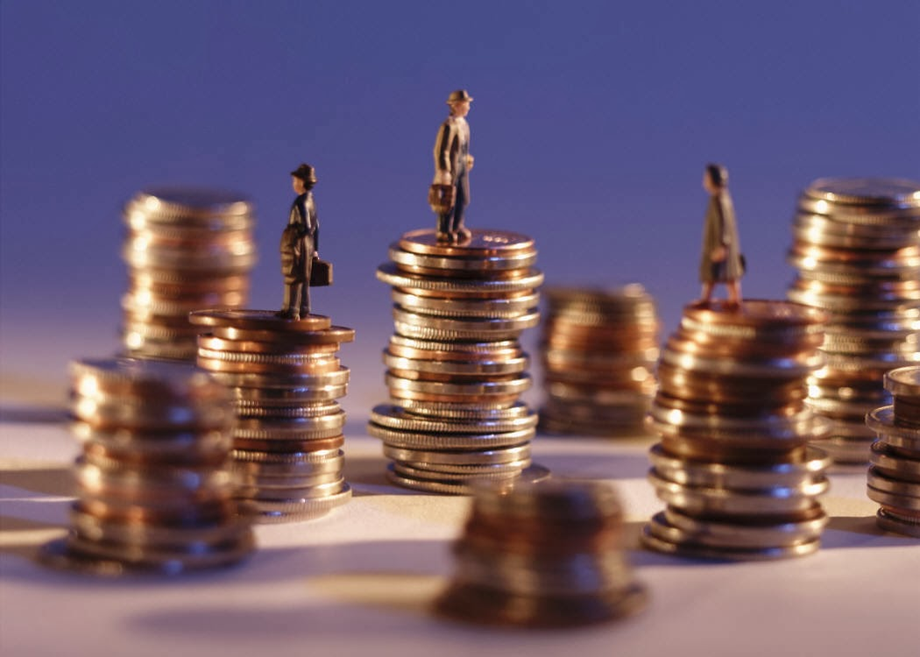
"…the skillful are not necessarily wealthy…" (9:11d NLT).

Slide 19
"…And those who are educated don't always lead successful lives…" (9:11e NLT).

Slide 20
We promote family values here— almost as often as we promote family members.
NEPOTISM

Slide 21
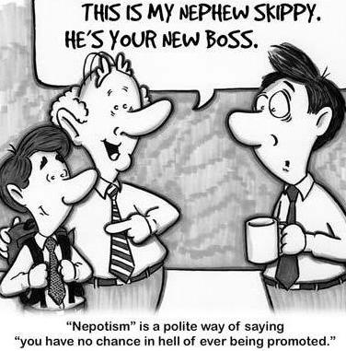
Nephew
This is my nephew, Skippy. He’s your new boss.
Notes:
A blogger named Ketan Joshi noted,
"One interesting thing I learned today is that the word 'Nepotism' is derived from the Latin word 'Nepos' or 'nepotis' which means 'nephew'. Um....Nepotism means favouritism granted to relatives regardless of merit. So why specifically nephew, rather than son? The answer is very interesting. This word came about in the middle ages, when the church clergy—specifically the Catholic clergy—had to take an oath of chastity, and could not (legally) father any children. So these dudes gave their nephews such positions of preference, as would normally be given to a son. Hence the word 'Nepotism'. (Nephewism, if you wish)"
http://ketanj.blogspot.com/2011/12/thing-about-nepotism.html

Slide 22
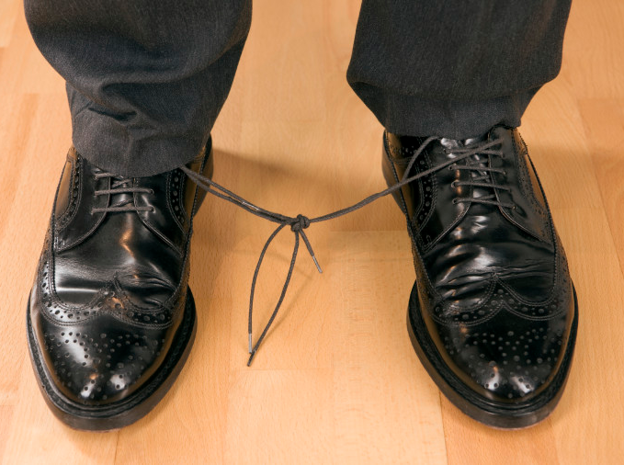
"…It is all decided by chance, by being in the right place at the right time" (9:11f NLT).

Slide 23
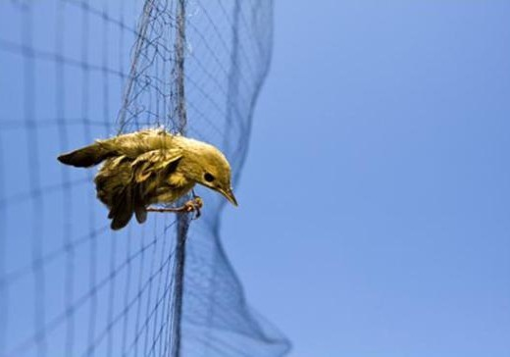
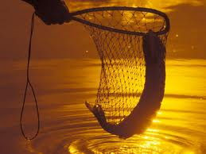
"People can never predict when hard times might come. Like fish in a net or birds in a trap, people are caught by sudden tragedy" (9:12 NLT).

Slide 24
B. Negligence can hinder wisdom (9:13-16).

Slide 25
"Here is another bit of wisdom that has impressed me as I have watched the way our world works. ¹⁴There was a small town with only a few people, and a great king came with his army and besieged it. ¹⁵A poor, wise man knew how to save the town, and so it was rescued. But afterward no one thought to thank him" (9:13-15 NLT).

Slide 26
"So even though wisdom is better than strength, those who are wise will be despised if they are poor. What they say will not be appreciated for long" (9:16 NLT).

Slide 27
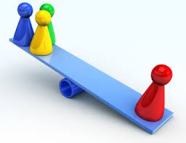
C. Foolishness can hinder wisdom (9:17–10:1).

Slide 28
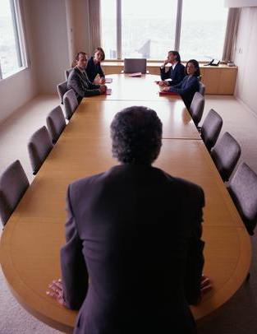
"Better to hear the quiet words of a wise person than the shouts of a foolish king" (9:17 NLT).

Slide 29
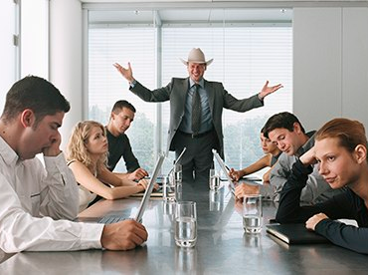
"Better to have wisdom than weapons of war, but one sinner can destroy much that is good" (9:18 NLT).

Slide 30
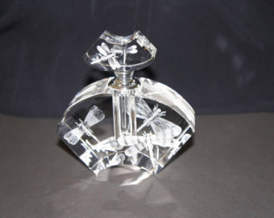
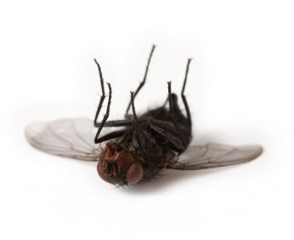
"As dead flies cause even a bottle of perfume to stink, so a little foolishness spoils great wisdom and honor" (10:1 NLT).
Notes:
Another example of how a little foolishness nullifies the great value of wisdom is when a foolish superior doesn't recognize the wisdom of one under him. How?

Slide 31
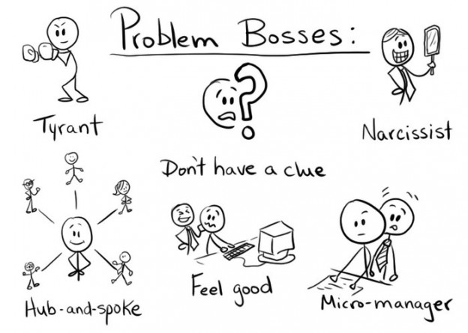
D. Foolish leaders can hinder wisdom (10:2-7).
Problem Bosses:
Tyrant
Narcissist
Don't have a clue
Feel good
Hub-and-spoke
Micro-manager

Slide 32
"A wise person chooses the right road; a fool takes the wrong one" (10:2 NLT).
Notes:
"I have set the LORD continually before me; Because He is at my right hand, I will not be shaken." (Ps. 16:8 NAU)

Slide 33
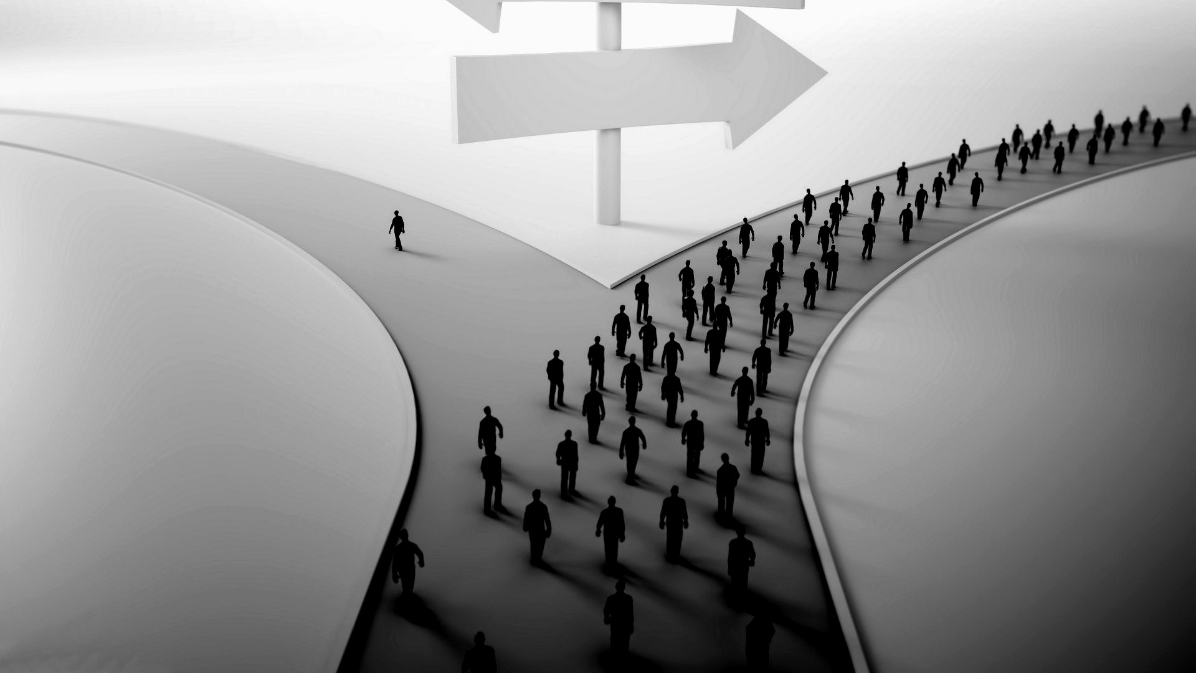
"A wise man’s heart inclines him to the right, but a fool’s heart to the left" (Eccl 10:2 ESV).
Ever wonder why conservatives are called right & liberals are called left?

Slide 34
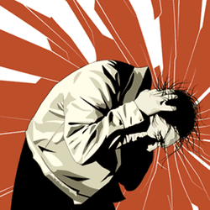
"You can identify fools just by the way they walk down the street!" (10:3 NLT).

Slide 35
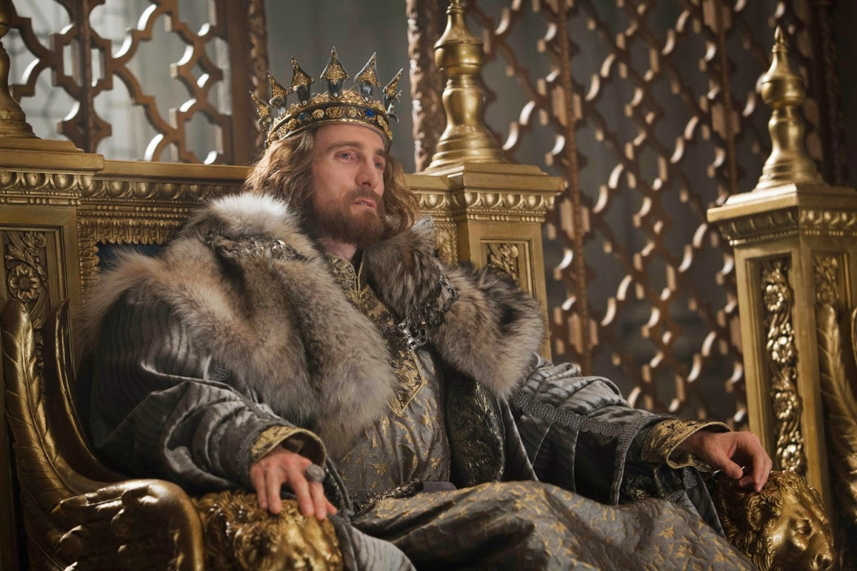
"If the anger of the ruler rises against you, do not leave your place, for calmness will lay great offenses to rest" (Ecclesiastes 10:4 ESV)

Slide 36
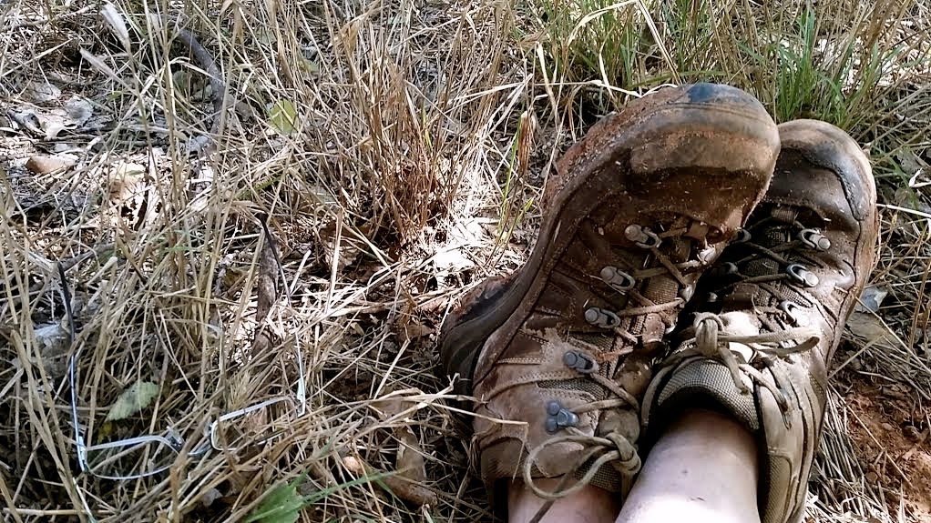
"There is another evil I have seen under the sun. Kings and rulers make a grave mistake ⁶ when they give great authority to foolish people and low positions to people of proven worth" (10:5-6 NLT).

Slide 37
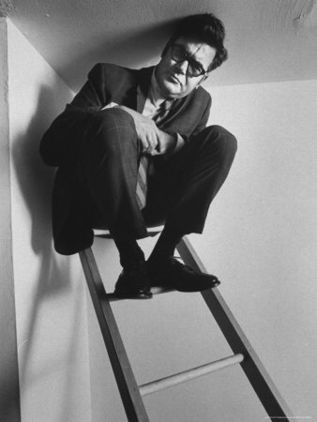
Climb the ladder to your level of incompetence

Slide 38
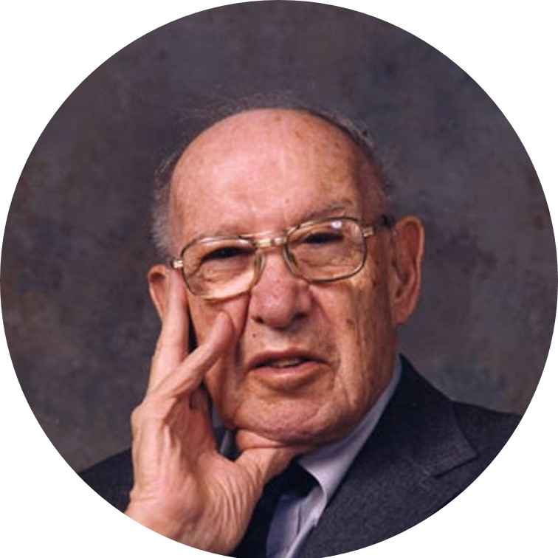
Drucker
"Efficiency is doing things right; effectiveness is DOING THE RIGHT THINGS."
—Peter Drucker

Slide 39
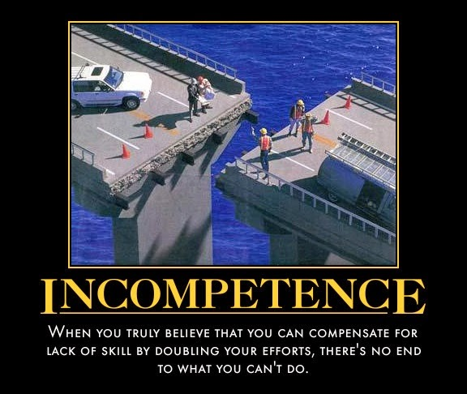
"I have even seen servants riding horseback like princes—and princes walking like servants!" (10:7 NLT).

Slide 40
Why doesn't wisdom always lead to success?

Slide 41
I. Life is unfair (9:11–10:7).
Notes:
The inequities of life afflict the wise as well as the rest of us!
Our existence does not have all accounts settled fairly yet.
Wisdom recognizes this truth that humanity is biased and inequitable.

Slide 42
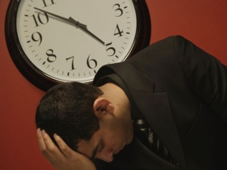
II. Life is uncertain (10:8-11).
Notes:
The unreliable nature of life hinders wisdom.

Slide 43
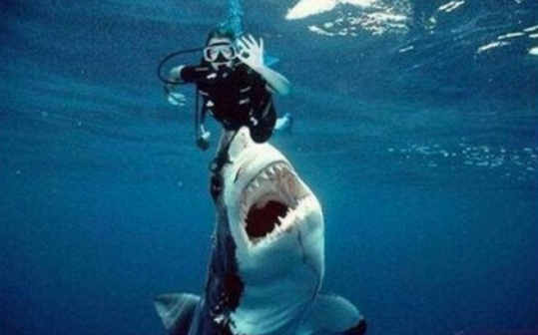
A. Accidents can hinder wisdom (10:8-10).

Slide 44
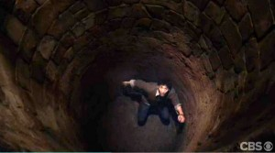
"Whoever digs a pit may fall into it" (10:8a NIV).
Notes:
The NLT renders this "well" but that isn't the meaning of the Hebrew.
You can fall into a pit that you actually dug (10:8a).

Slide 45
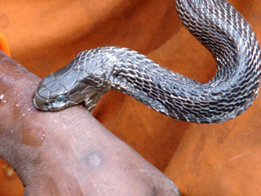
"When you demolish an old wall, you could be bitten by a snake" (10:8b NLT).
Notes:
You can get snakebites while working hard (10:8b)

Slide 46
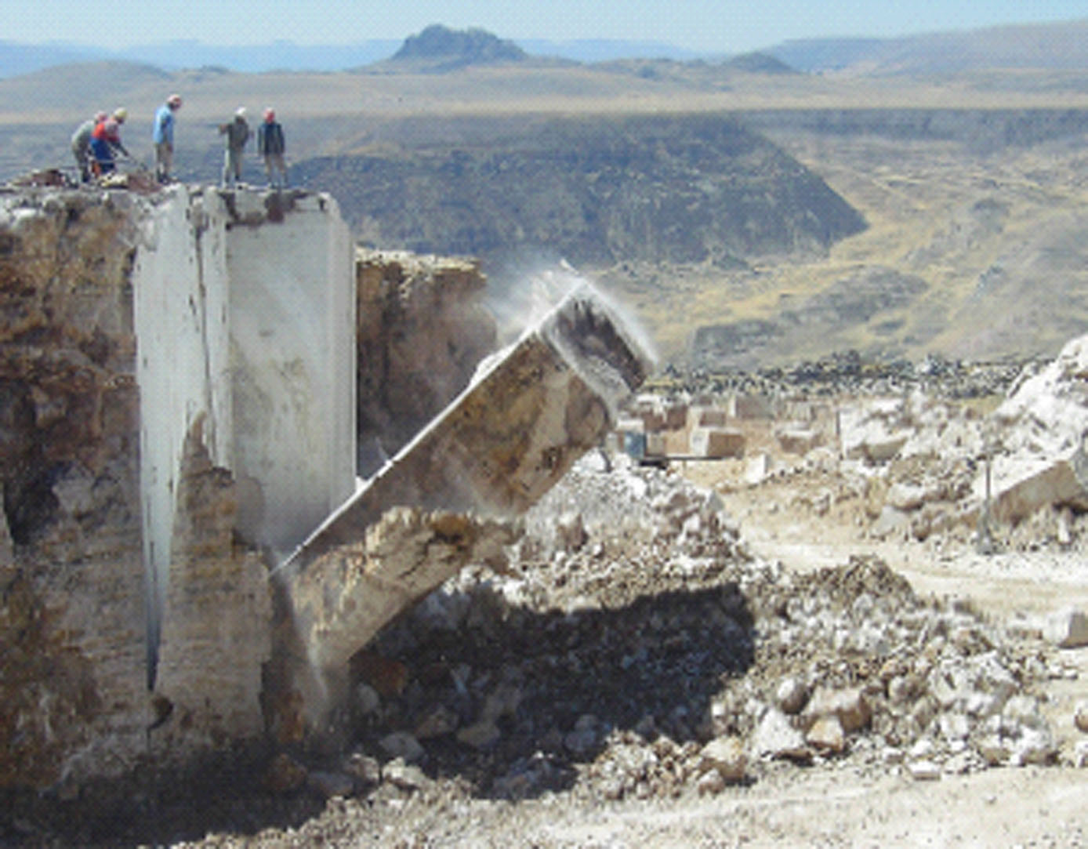
"When you work in a quarry, stones might fall and crush you" (10:9a NLT).
Notes:
You can get hurt while quarrying rock (10:9a)

Slide 47
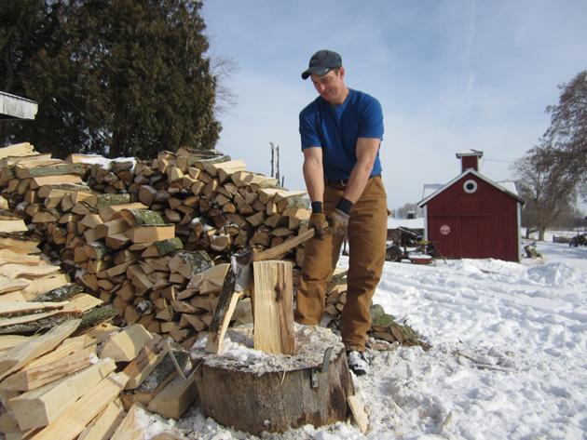
"When you chop wood, there is danger with each stroke of your ax" (10:9b NLT).
Notes:
You can get hurt from logs that you split (10:9b)

Slide 48
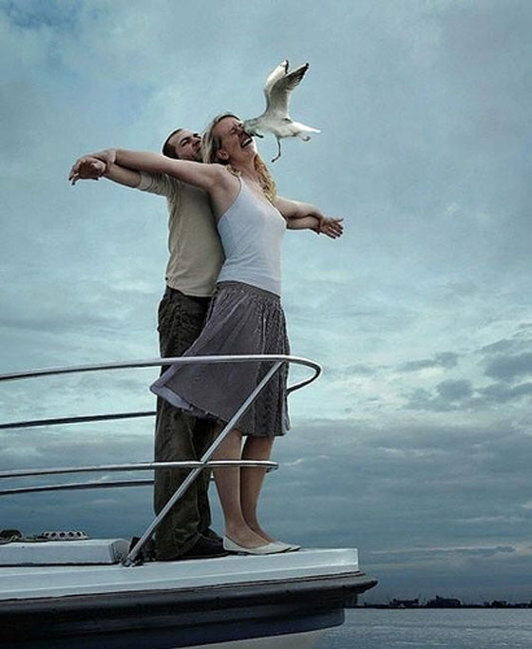
B. Bad timing can hinder wisdom (10:11).

Slide 49
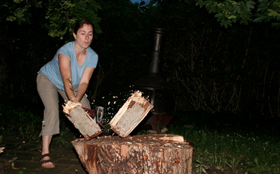
"Using a dull ax requires great strength, so sharpen the blade" (10:10a NLT).
Notes:
Time spent to sharpen your ax is worth it (10:10a)

Slide 50
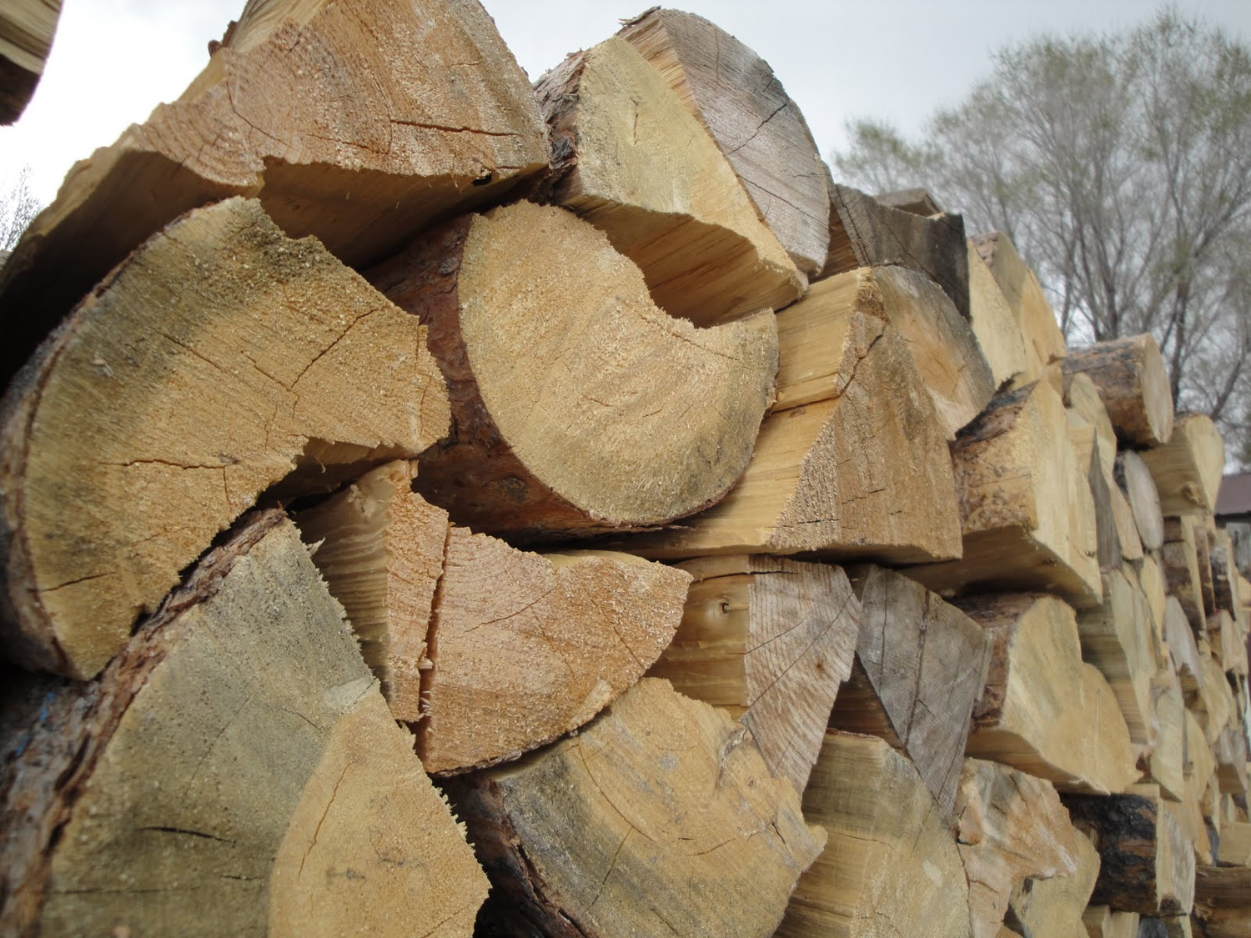
"That's the value of wisdom; it helps you succeed" (10:10b NLT).
Notes:
Wisdom in all situations brings more chance of success (10:10b)

Slide 51
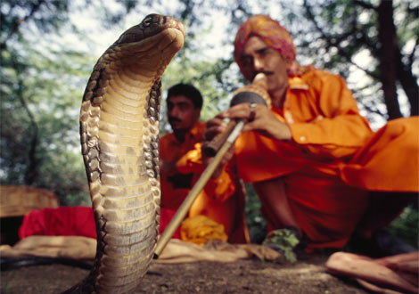
"If a snake bites before you charm it, what's the use of being a snake charmer?" (10:11 NLT).
Notes:
Wisdom has no gain unless used at the proper time (10:11).

Slide 52
So why doesn't wisdom always lead to success?

Slide 53
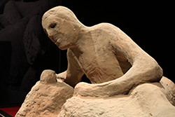
Main Idea
Wisdom doesn't guarantee success because life is unfair and uncertain.

Slide 54
Questions
How has your wisdom gone unrewarded?
How can you avoid silly mistakes that ruin what you accomplish by wisdom?
What should you do when your boss doesn't notice your great insights?
How is bad timing hindering the good you do?
How would God counsel you in this situation?

Slide 55
Don't trust wisdom—trust God!

Slide 56
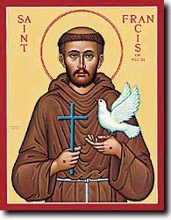
A Wise Prayer
"Lord, grant me the serenity to accept the things I cannot change,
the strength to change the things I can,
and the wisdom to know the difference."
—St. Francis of Assisi

Slide 57
Black

Slide 58
OT Preaching link at BibleStudyDownloads.org
Get this presentation and script for free!

